Slide 1
British Customer Bookings Predictive Modeling
By Adedayo Adeboye

Slide 2
Executive Summary
Executive Summary
Introduction
Methodology
Results
Conclusion

Slide 3
Introduction
Project background and context
There has been a mushrooming of players within the airline industry, each trying to delight their customers through innovation and value. The customer too expects more from every flight they take. Even before acquiring customers, airlines strive to meet and exceed customer expectations with technology.
The use of data and predictive models makes this possible. With a predictive model, the quality of the data you use to train the machine learning algorithms is crucial. In order to build a high-quality predictive model, you must manipulate and prepare the provided customer booking data.
The key to understanding your predictive model is to interpret the results in order to understand how "predictive" the data really was and whether we can use it to forecast the target outcome (customers buying holidays). You should therefore evaluate the model's performance and output, and how each variable contributes to the model's effectiveness.

Slide 4
Methodology
Model used:
LogisticRegressionl
DecisionTreeClassifier
KNeighborsClassifier
Random Forest Classifier
SVC
Model Evaluation
R Square Value
Root Mean Square Error
Mean Absolute Error
Score
Precision score
f1 score
Confusion Matrix
Executive Summary
Perform data wrangling
Feature selection using:
Univariate Feature Selection
Correlation Matrix
Perform exploratory data analysis
Perform predictive analysis using classification models

Slide 5
KNeighbors Classifier Model
To know whether we can trust our method or system, we need to evaluate it. We used the following evaluation method to select the best model suitable for our prediction.
First, we ensure our independent variables are carefully selected using Univariate Feature Selection that shows a correlation with our dependent variable.
The clean split dataset(X-train & y-train) is fitted using the above-selected models. We then proceeded to predict using our X-test for the selected models with respective results.
SVC Model
Model Development
Logistics Model
03
Decision Tree Model
Random Forest Model

Slide 6
Model Evaluation
Score:
We calculate the score of our model on the train and test to determine if our models are over-fitted, and under-fitted.
Errors
The following error's evaluation was performed: R squared, Root Mean Squared Error, and Mean Absolute Error, f1 score, Precision score & Confusion Matrix
Model Selection:
During the close evaluation, we observed that the Random Forest have most dependable perdition base on evolutions , with extremely low error rates without much margin and without a lot of overfitting.
Model Evaluation
Score
Errors

Slide 7
Recommendation
Selected Models
Random Forest & KNN Model Recommended
R squared value: -0.35214439791904
Root Mean Squared Error : 0.412916456441251
Mean Absolute Error : 0.1705
Precision score on train : 0.66
Precision score on test : 0.26
f1 score on train : 0.32
f1 score on test : 0.13
score on train: 0.86535
score on test: 0.8295
R squared value: -0.1737089201877935
Root Mean Squared Error : 0.3847076812334269
Mean Absolute Error : 0.148
Precision score on train : 0.0
Precision score on test : 0.0
f1 score on train : 0.0
f1 score on test : 0.0
score on train: 0.85005
score on test: 0.852
Logistics
KNeighbors
R squared value: -0.1737089201877935
Root Mean Squared Error : 0.3847076812334269
Mean Absolute Error : 0.148
Precision score on train : 0.0
Precision score on test : 0.0
f1 score on train : 0.0
f1 score on test : 0.0
score on train: 0.85005
score on test: 0.852
R squared value: -0.29583809161273944
Root Mean Squared Error : 0.40422765862815474
Mean Absolute Error : 0.1634
Precision score on train : 0.97
Precision score on test : 0.31
f1 score on train : 0.66
f1 score on test : 0.14
score on train: 0.922875
score on test: 0.8366
SVC Model
Random Forest

Slide 8
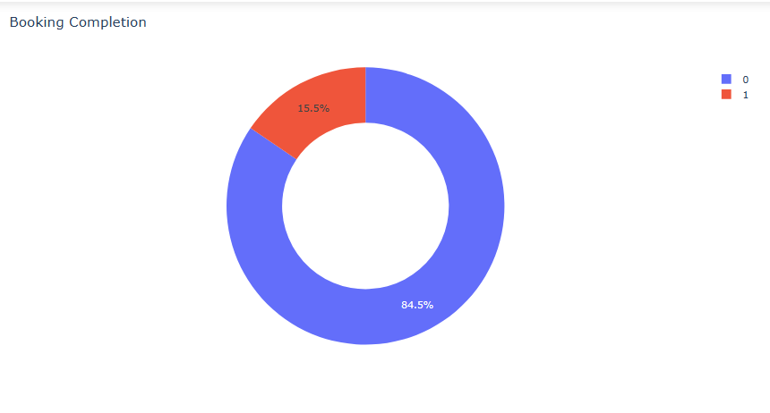
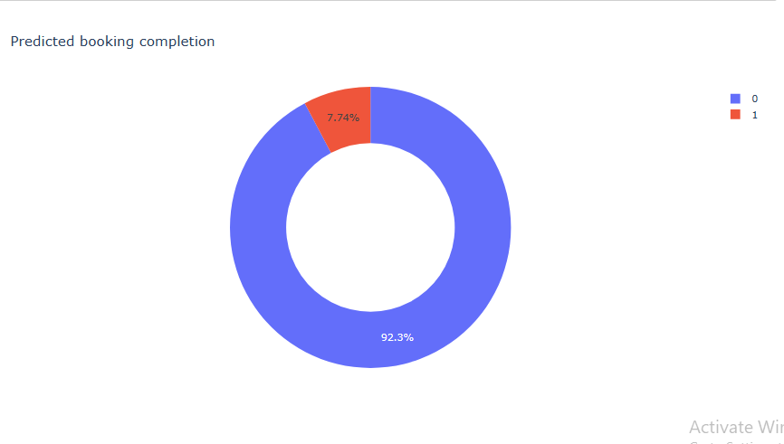
It was determined that the Random Forest model was able to provide the most reliable prediction results based on the analysis of the selected model. We could predict 92.3% of the entries to be predicted "0" while 7.73% predicted and classified “ 1 “.
We could observe that the actual percentage of the data used for prediction was 84.5% classified "0" while 15.5% classified “ 1 ".

